Slide 1
Recommander system v20
It biblichor
rafed

Slide 2
Plan
Workflow scheduling
Asynchron run python

Slide 3


I. Workflow scheduling

Slide 4
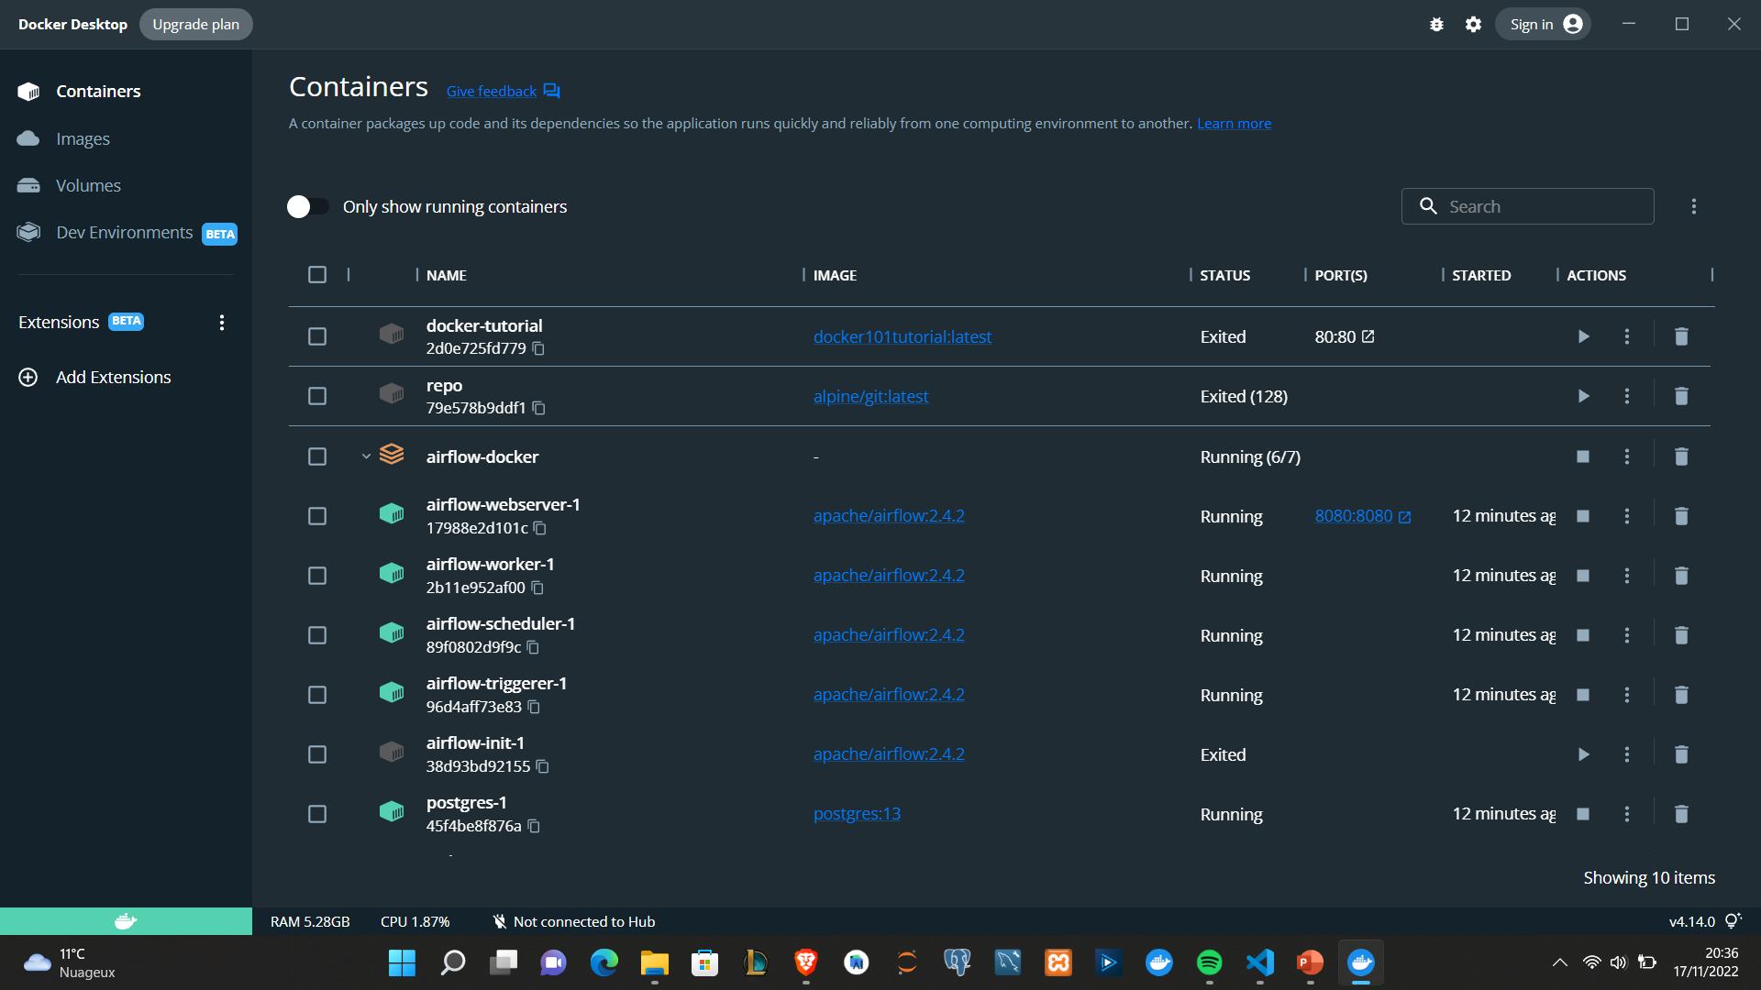

Slide 5
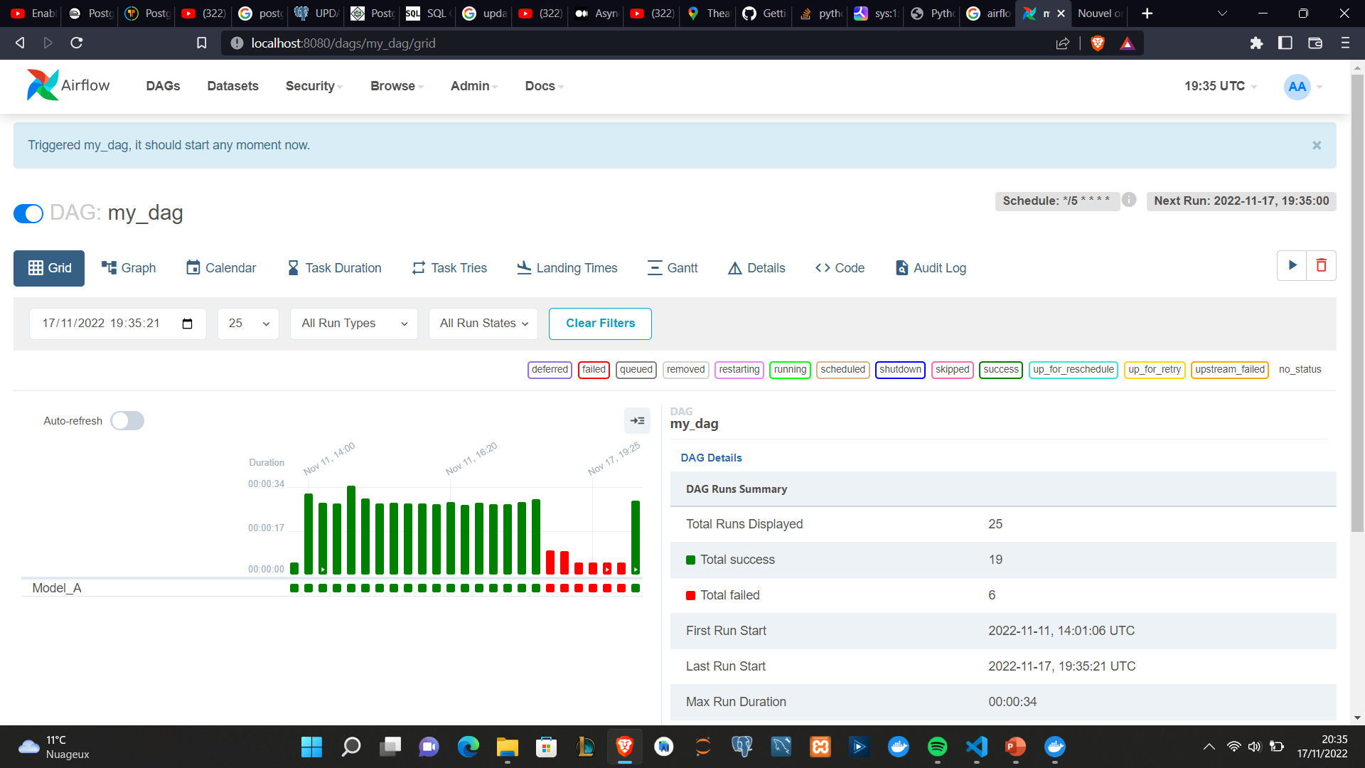

Slide 6
Problem
Run in local machine -> can’t run 24h
Sol : running the WF on our server

Slide 7
II. Asynchron run python
1) Multithreading
2) Multiprocessing
3) Asyncio

Slide 8
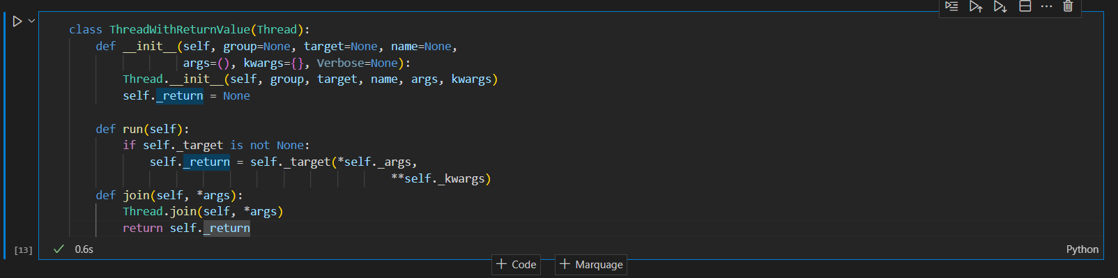
1) Multithreading

Slide 9
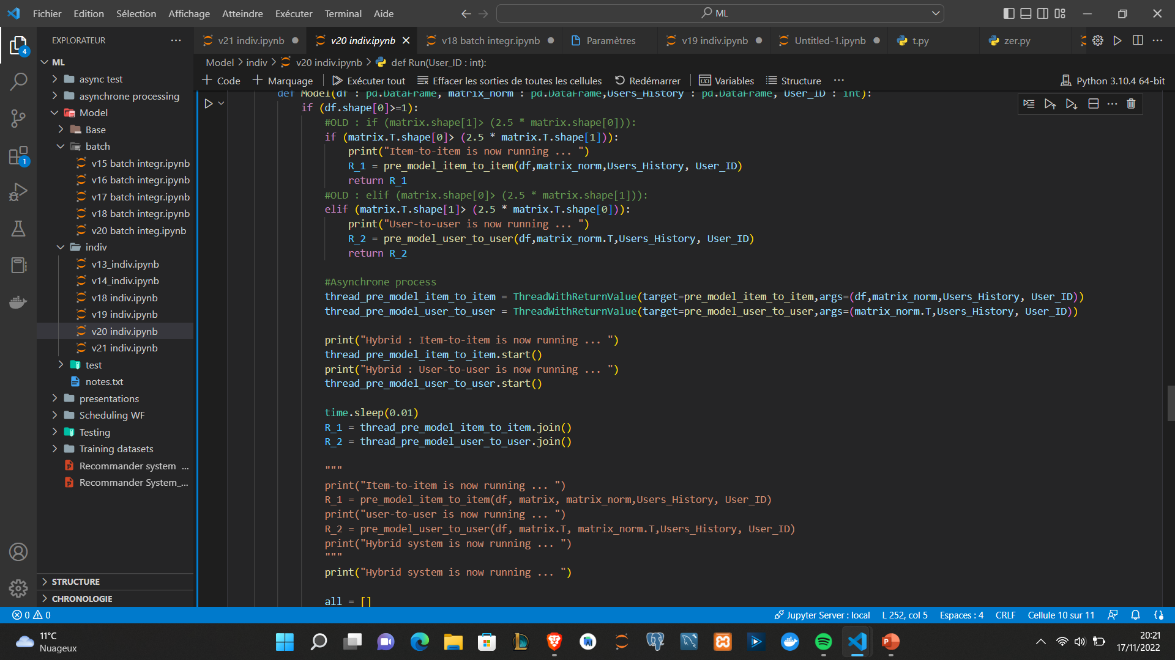

Slide 10
Multiprocessing & Asyncio
2) Multiprocessing : Stopped working on it
3) Asyncio : still working on it & setting it up on our model

